Slide 1

File System Concepts in Operating Systems
A file system is a fundamental component of operating systems, providing a structured way to organize and access data and programs. It allows for efficient storage and retrieval of information, making it possible for users to work with files in a user-friendly manner.
k
Presented by :
Sajedul karim
ASH2101027M
&
Aklima Akter Sanjana
BBH2101026F

Slide 2

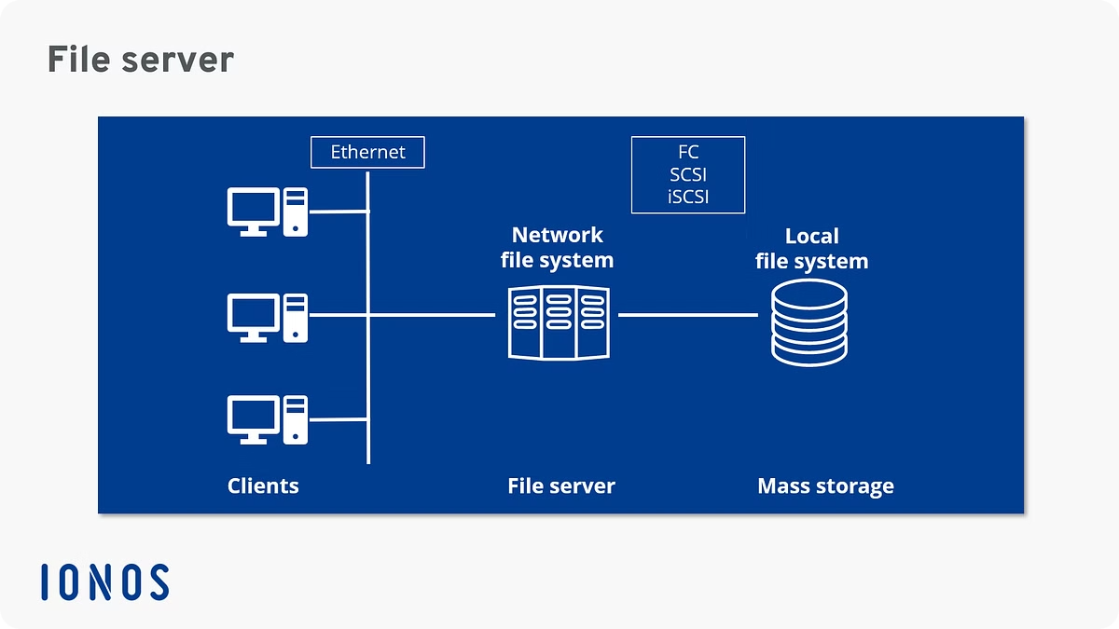

What is a File System?
Storage and Access
Organization
The file system provides the mechanism for storing data and programs on a computer.
It organizes data into a hierarchical structure, making it easier to find and manage information.
Security
The file system manages permissions, ensuring that users can access only authorized files.

Slide 3

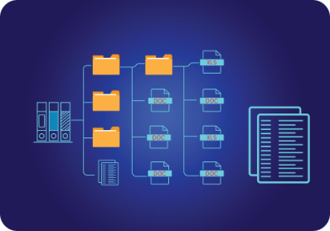
File System Concepts: Files
Field
Record
A field represents a single piece of information within a record.
A record is a collection of related fields that represent a complete unit of data.
File
Database
A file is a collection of related records, organized logically.
A database is a collection of related files, managed as a single unit.

Slide 4
File Attributes
1
Name
2
Size
3
Type
A unique identifier that distinguishes it from other files.
The amount of disk space a file occupies, measured in bytes.
Indicates the file's content format, such as text, image, or executable.
4
Date and Time
5
Permissions
Records when the file was created, modified, or last accessed.
Control access levels for different users, granting read, write, or execute privileges.

Slide 5
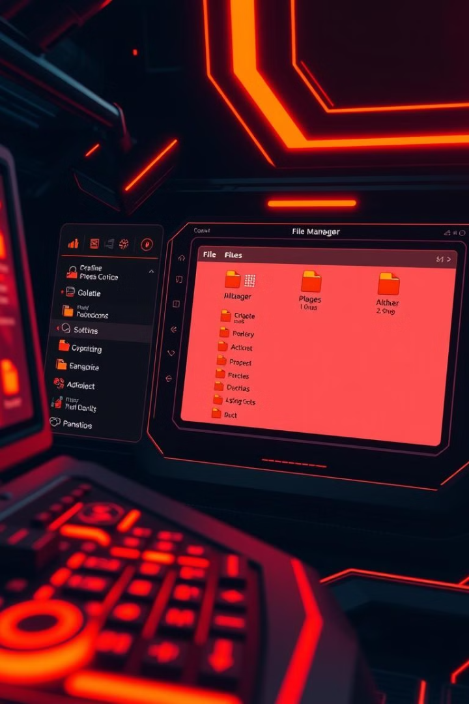
File Operations
Create
Read
This operation allows users to create new files. The user specifies a filename and the file system allocates disk space for it.
This operation enables users to access and retrieve data from a file. The contents of the file are transferred from secondary storage to main memory.
Write
Delete
This operation allows users to modify the contents of an existing file by adding or changing data. The updated data is written to the file on disk.
This operation removes a file from the file system. The disk space occupied by the file is freed up for reuse.

Slide 6
File Operations: Managing Information
Create
1
A new file is created, assigning it a name and type, ready for data input.
2
Read
The file's content is accessed and retrieved for viewing or processing.
Write
3
Data is added to or modified within the file, changing its contents.
4
Delete
The file is permanently removed from the file system, erasing its data.
Rename
5
The file's name is changed, updating its identifier within the system.
6
Copy
A duplicate of the file is created, preserving its contents and attributes.
Move
7
The file is relocated to a different location within the file system.

Slide 7
File Types
Text Files
Binary Files
Data Files
Text files store plain text data, such as documents, code, and configuration files. They are typically denoted by extensions like .txt, .doc, .pdf, and .html.
Binary files store data in a format that is not directly readable by humans. They often contain images, videos, audio, and executable programs. They are usually denoted by extensions like .jpg, .mp3, .exe, and .zip.
Data files store structured information in a specific format, such as spreadsheets, databases, and configuration files. They are often denoted by extensions like .csv, .xls, and .xml.

Slide 8

Access Method
1
Sequential Access
Data is accessed in a linear order, starting from the beginning. Each record is accessed sequentially, like reading a book.
2
Direct Access
Data is accessed randomly, allowing users to directly access specific records without reading through preceding records.
3
Indexed Sequential Access
Combines features of sequential and direct access, allowing both sequential access and direct access to specific records using an index.

Slide 9
Directory Structure
Root Directory
1
The top-level directory, containing all other directories and files.
Subdirectories
2
Folders within the root or other subdirectories, organizing related files.
Files
3
The actual data or programs stored within the directory structure.

Slide 10
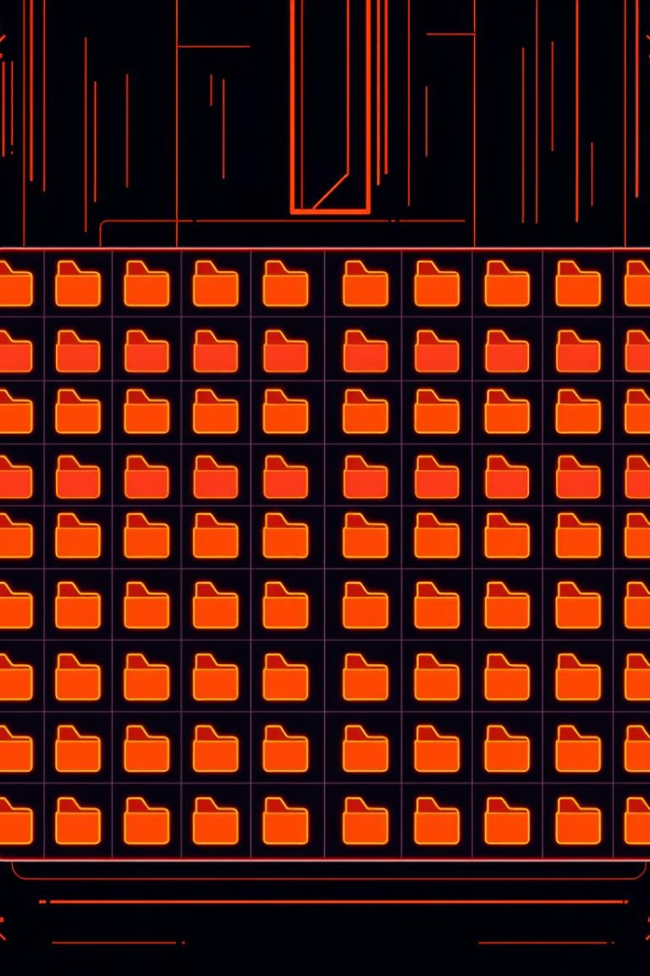



Single-Level Directory
Root Directory
All files are stored in the root directory.
File Access
Files can be accessed directly by their names, as there is no hierarchy.
Limited Organization
This structure is simple but lacks organization for large sets of files.

Slide 11

Two-Level Directory
2
1
Root Directory
Subdirectories
The top level, containing all subdirectories and files.
Organized groups of files, nested within the root.

Slide 12
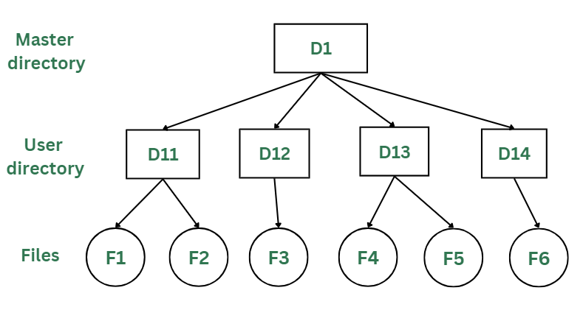
Two-Level Directory Structure
Improved Organization
Enhanced Navigation
By organizing files into nested directories, finding specific files becomes easier, enhancing navigation and efficiency. This structure makes it simpler to locate files by their category, reducing the time spent searching for specific information.
Two-level directories allow for grouping files by category, creating a more organized and logical file system. This structure improves upon the single-level approach by providing a hierarchical arrangement.

Slide 13

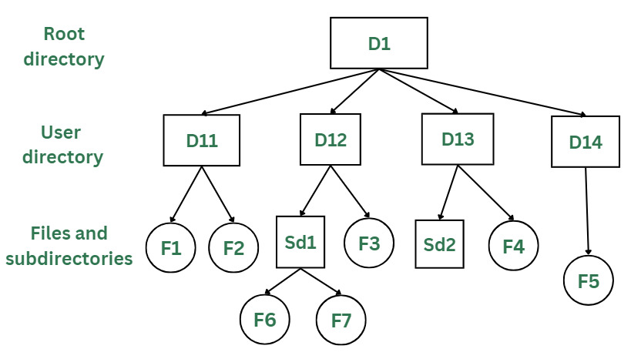
Tree-Structured Directories
1
Hierarchical Organization
Files are organized into a tree-like structure, with directories nested within each other. This provides a logical way to group related files together.
2
Improved Navigation
This structure allows for easy navigation and location of files, as they are organized by category and sub-categories.
3
Enhanced Scalability
This hierarchical arrangement effectively handles large datasets, ensuring efficient management of large numbers of files.

Slide 14

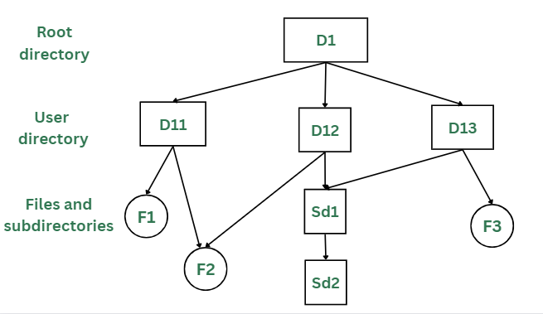
Acyclic Graph Directories
Flexible Organization
Efficient Access
Allows for complex relationships between files, going beyond the limitations of hierarchical structures.
Enables faster access to files by allowing multiple paths to reach a specific file.
Potential for Loops
While offering flexibility, it's crucial to prevent cycles, as they can lead to infinite loops and errors.

Slide 15
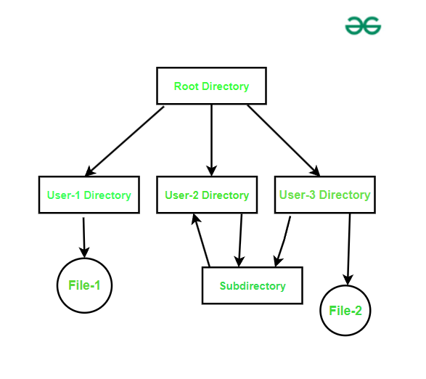



General Graph Directories
Unstructured Relationships
1
Files can have multiple parent directories.
Acyclic Graph
2
No cycles, ensuring efficient navigation.
Tree Structure
3
Hierarchical organization, single parent.

Slide 16
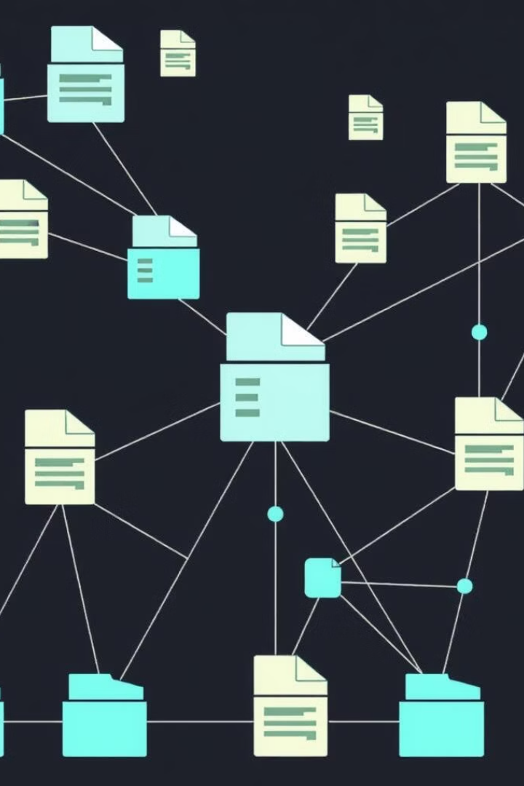
Challenges in File System Design
Security
Reliability
Protecting files from unauthorized access, modification, or deletion is crucial.
Ensuring data integrity and availability, even in the face of errors or hardware failures, is paramount.
Performance
Scalability
Optimizing file system operations for speed and efficiency, especially with large files and complex directory structures, is a key challenge.
Designing a file system to handle growing amounts of data and user demands without compromising performance is vital.

Slide 17


